Slide 1





RealtyAI Smart Real Estate Insight Platform
AI platform that evaluates property conditions,predicts price trends,segments satellite images of real estate regions

Slide 2

TABLE OF CONTENTS
PROJECT OVERVIEW
DATASET OVERVIEW AND KEY INSIGHTS
METHODOLOGY
EXPLORATORY DATA ANALYSIS
VISUALIZATION
DATA PREPROCESSING
FEATURE EXTRACTION
MODEL ARCHITECTURE
TRAINING AND EVALUATION
results
USER INTERFACE
CHALLENGEs
FUTURE SCOPE
CONCLUSION

Slide 3


PROJECT OVERVIEW
OBJECTIVE: To build an AI-powered platform that provides accurate property condition assessments, reliable price trend predictions, and satellite-based regional analysis, enabling informed decision-making for property buyers, investors, and urban planners
OUTCOMES:
Prepared real estate images and data in a clean,organized way so the models can understand them better.
Built AI models that can recognize property features, segment satellite images, and predict how prices may change over time
Created an easy-to-use dashboard that presents all insights visually, making it simple for users to explore and understand real estate trends.

Slide 4

DATASET OVERVIEW AND KEY INSIGHTS
Datasets | Structure | Size | Strengths
House Prices – Advanced Regression | 1,460 rows, 81 features (tabular) | ~500 KB | Rich property attributes, ideal for price prediction
SpaceNet Satellite Images | Satellite images in NumPy arrays | Medium–large (hundreds of MB) | High-quality labeled imagery for segmentation
Zillow Economics Data-City Time Series | City-wise real estate time-series indicators | ~600–700 MB | Long-term trend data for forecasting
REASON OF CHOOSING THE DATASET:
Covers all required tasks: House Prices → property valuation,SpaceNet → satellite segmentation,Zillow Zecon → price trend forecasting.
High-quality real-world data: All three datasets are reliable, well-structured, and widely used for real estate and ML research.
Diverse data types for a complete solution: Combines tabular, image, and time-series data, enabling a comprehensive AI platform for real estate analysis.

Slide 5

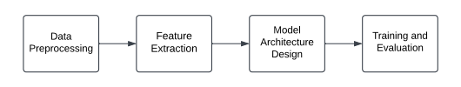
METHODOLOGy
DATA PREPROCESSING
Clean tabular data,prepare satellite images and format time-series for
forecasting.
FEATURE EXTRACTION
Extract property features, spatial patterns from satellite images and temporal trends from historical data
MODEL ARCHITECTURE EXTRACTION
Design U-Net for segmentation, ML/DL models for valuation, and LSTM/ARIMA for price forecasting
TRAINING AND EVALUATION
Train all models on their datasets, evaluate using key metrics, and optimize performance.

Slide 6
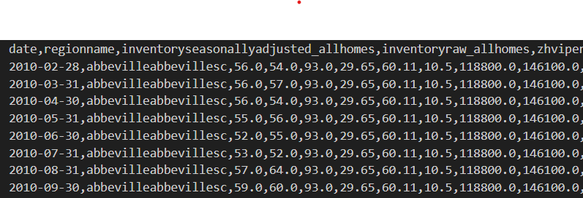
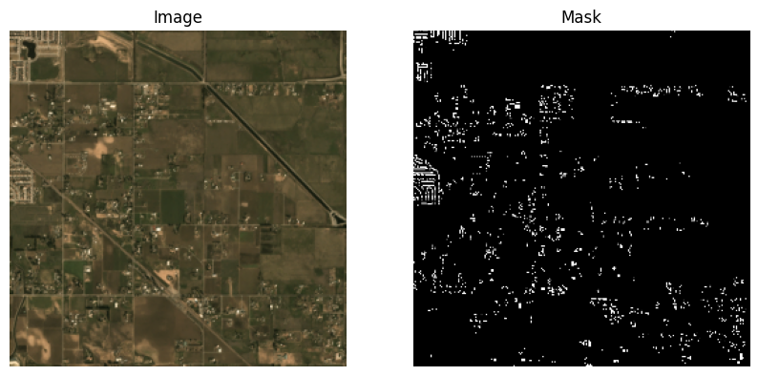
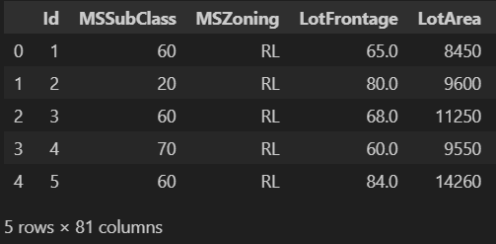

Exploratory Data Analysis
Satellite image&Mask
House Price
Zillow city time series
KEY FINDINGS:
Property features show strong influence on housing prices.
Satellite images provide clear structures suitable for accurate segmentation.
Time-series data reveals consistent upward trends useful for forecasting.

Slide 7
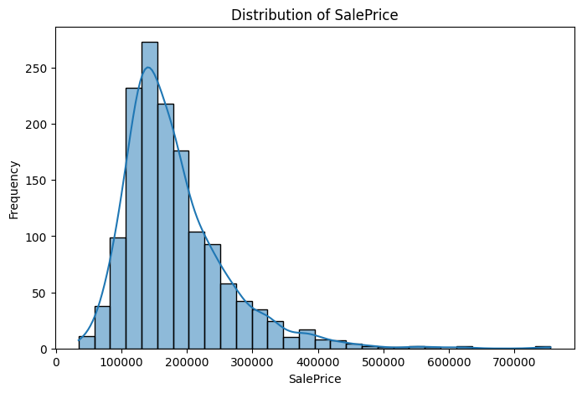
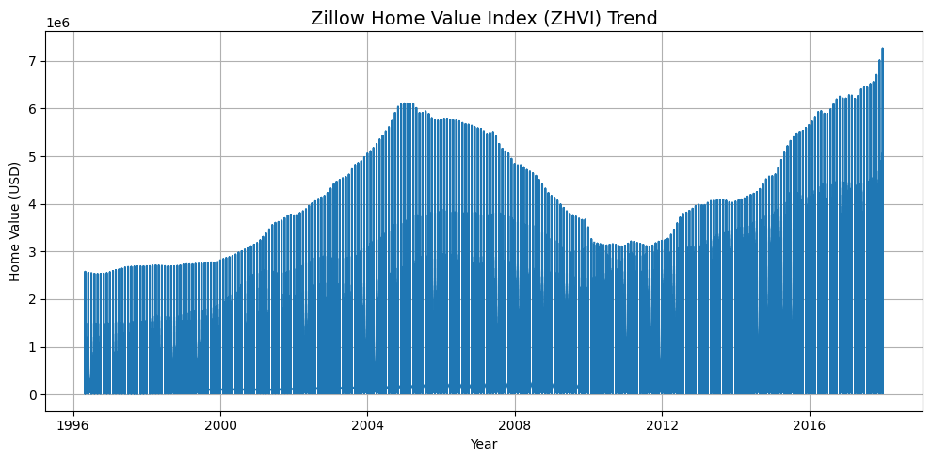
Visualization
The histogram illustrates how house prices are distributed, showing a concentration of homes in the mid-price range and fewer high-value properties. It helps identify the overall price spread and potential outliers.
This chart shows the yearly trend of the Zillow Home Value Index. Illustrating how property values have changed over time. It highlights overall market growth and helps identify patterns useful for price forecasting.

Slide 8
Data Preprocessing
1.REMOVED DUPLICATES:
Removed duplicate and inconsistent entries to ensure dataset reliability.
2.CLEANING THE TEXT DATA:
Cleaned missing, incorrect, and noisy data for better model performance.
3.NORMALIZATION:
Applied normalization to scale features and improve training stability.

Slide 9
Feature Extraction
1.SATELLITE IMAGE:
Satellite images are processed using a U-Net model to extract structural patterns from land surfaces. These extracted spatial features allow the system to classify whether an area is residential or commercial.
2.HOUSING TABULAR
The housing dataset undergoes cleaning, encoding, and scaling to derive meaningful numerical features. Important characteristics like room count, area, year built, and neighborhood attributes are extracted. These engineered features improve the performance of the price-prediction model.
3.ZILLOW TIME SERIES :
Zillow historical price data is transformed into time-dependent features capturing trend, growth, and patterns. Moving averages, rate of change, and seasonal indicators are extracted to feed the LSTM model. These features help forecast property values accurately over future years.

Slide 10
Model Architecture
1️⃣ U-Net for Satellite Segmentation
Uses encoder–decoder blocks to extract image features and generate pixel-wise masks for land-use detection.
2️⃣ LightGBM for Price Prediction
A tree-based boosting model that learns patterns from tabular features to estimate property values accurately.
3️⃣ LSTM for Price Forecasting
A recurrent neural network that captures time trends and seasonal patterns for multi-year value prediction.
🛰️ SATELLITE SEGMENTATION
(UNET)
💰PRICE PREDICTION(LIGHTGBM)
📈TIME SERIES FORECASTING
(LSTM)

Slide 11
Training and Evaluation
During training, the dataset was divided into 80% for training and 20% for testing, with 20% of the training data used for validation. This approach ensures that the model’s generalization ability is fairly evaluated.
Final models are tested using unseen data and metrics such as IoU (segmentation), RMSE (price prediction), and MAE (forecasting) to measure overall reliability
Model | Key Metrics (Train) | Key Metrics (Validation/Test) | Performance Summary
UNet (Satellite Segmentation) | Loss: 0.1991 • Accuracy: 92.97% | Val Loss: 0.2070 • Val Accuracy: 92.63% | Strong segmentation accuracy with good generalization.
LSTM (Zillow Forecasting) | Loss: 8.0e-05 • MAE: 0.0051 | Val Loss: 9.9e-05 • Val MAE: 0.0097 | Excellent trend learning with very low forecasting error.
LightGBM (House Price Prediction) | R² (OOF): 0.9076 | RMSE: 23,744 • MAE: 15,162 • MAPE: 8.75% | High predictive power with ~91.25% accuracy overall.

Slide 12
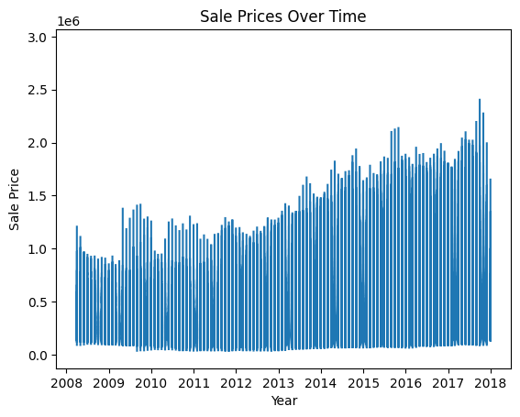
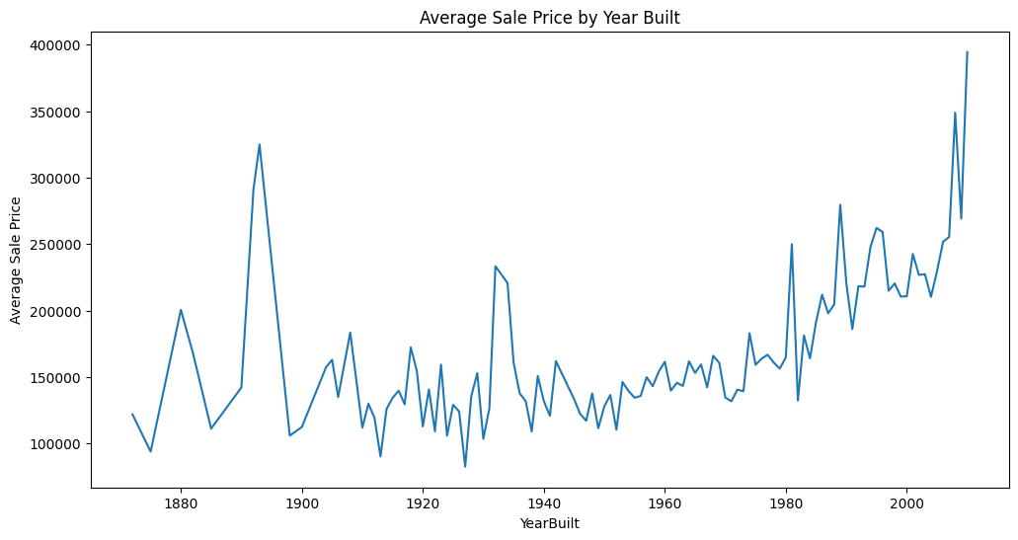
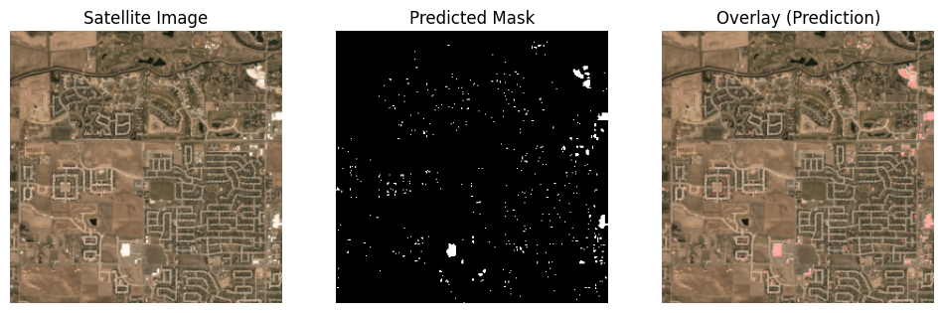
Results
PRICE TREND OVER TIME
PRICE PREDICTION
SATELLITE SEGMENTATION
🏡 Predicted: Residential Area

Slide 13

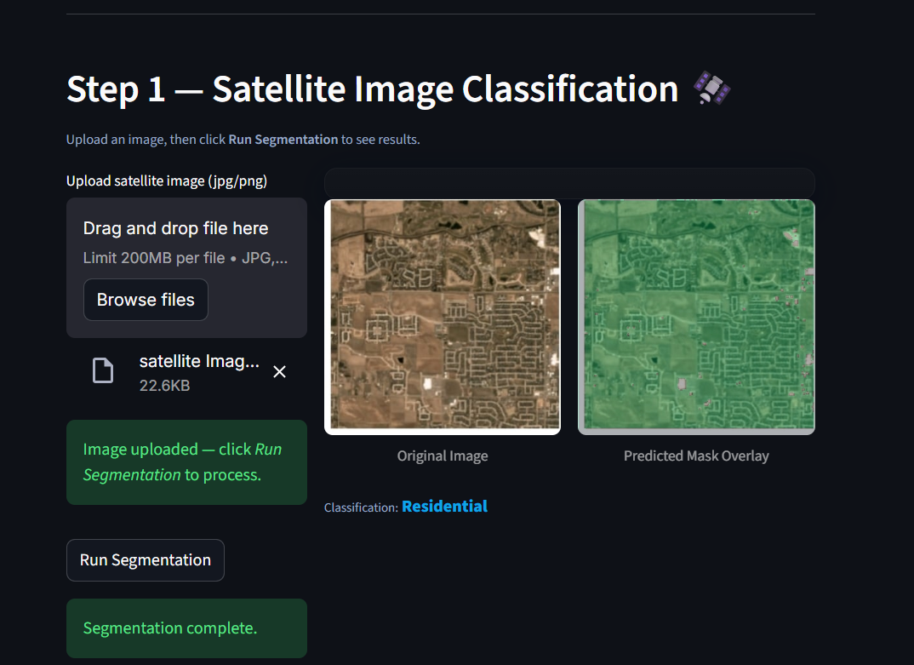
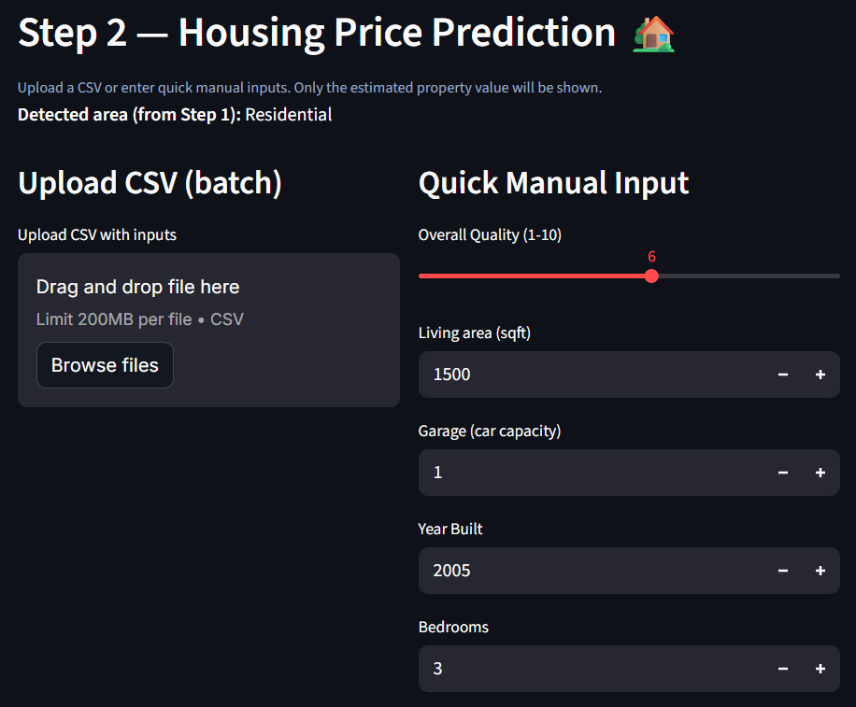
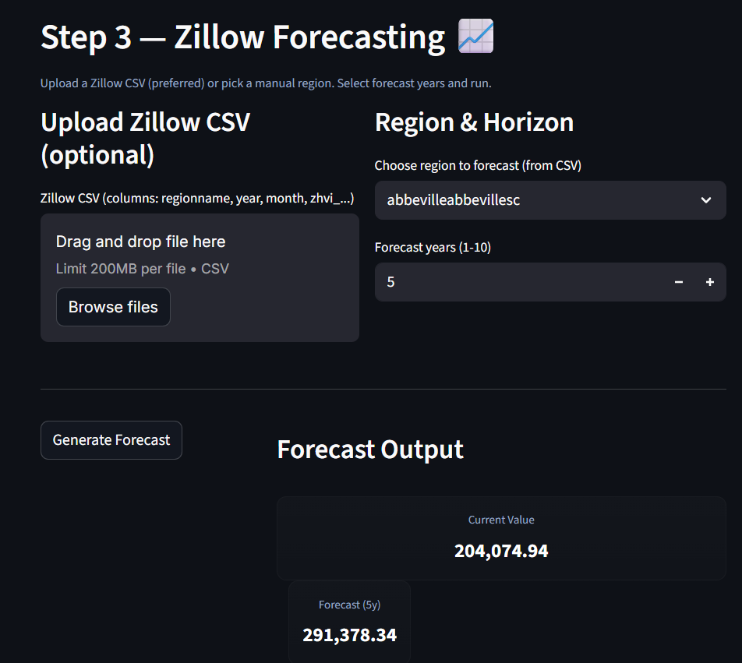
USER INTERFACE

Slide 14
Challenges
1. DATA QUALITY
missing housing attributes, and region-wise price fluctuations made preprocessing and normalization essential.
2.OVERFITTING
Preventing overfitting, especially with a large number of values and data for some feature, required careful regularization.
3.INTEGRATION
Combining segmentation, valuation, and forecasting into a single pipeline involved managing large models, GPU/CPU constraints, and stable Streamlit session flow.

Slide 15

Future Scope
The system can be scaled to include more cities and countries, allowing it to analyze diverse property trends. This expansion increases the platform’s usefulness for buyers, investors, and planners across different regions.
By connecting to live market feeds, updated satellite images, and economic indicators, the platform can continuously refresh predictions. This real-time capability makes forecasts more accurate and responsive to changing market conditions.

Slide 16

CONCLUSION
Realty AI successfully combines satellite segmentation, price prediction, and market forecasting into a unified decision-support system.
By integrating U-Net, LightGBM, and LSTM models, the platform delivers accurate, data-driven insights that help users understand property conditions and future trends.
This project demonstrates how AI can transform real-estate analysis into a faster, more reliable, and more accessible process.

Slide 17


THANK YOU

